Slide 1
Team: WellsWealthExpress
Members: Srinivasa Bagurubilli
Rajesh Kumar Das
Rajeswar Guda
Kinandu Mandadapu
Anand Vemulapati

Slide 2
Hackahon Challenge#4 – Click2Invest
Background: Customers should not experience friction when they want to utilize Wells Fargo products and services. There is no straightforward path to identify how to invest in a company behind a retail product.
Problem Statement:
Customer can take a picture of a product in a Wells Fargo application and be presented with information on the company and related investment products with the options to invest.
Example: Customer takes photo of their Starbucks coffee mug and is directly linked to purchase stock.
Expected Benefits:
Generate additional revenue for the bank by providing an “easy button” into investing.
Expand customer base to more tech savvy clients.

Slide 3

High level design
Speech Process
Image Process
Text Process
Wells Trading
Easy2Invest App
(landing page)
Easy2Invest App
(company details page)
Notes:
NYSE Listings Directory: https://www.nyse.com/listings_directory/stock Ex: SBUX for Starbucks, WFC for Wells Fargo, DPZ for Dominos Pizza Inc, OTEX for Open Text, JPM for JPMorgan Chase & Co
Company page based on its Stock Symbol: https://www.nyse.com/quote/XNYS:JPM , https://www.nyse.com/quote/XNYS:WFC etc.
The NASDAQ (National Association of Securities Dealers Automated Quotations) is an electronic stock exchange with more than 3,300 company listings. It currently has a greater trading volume than any other U.S. stock exchange, carrying out approximately 1.8 billion trades per day. The NYSE is still considered the biggest exchange because its market capitalization far exceeds that of the NASDAQ. The NASDAQ trades shares in a variety of companies, but is well known for being a high-tech exchange, trading many new, high growth, and volatile stocks. This is partially due to the fact that the listing fees on the NASDAQ are significantly lower than those for the New York Stock Exchange whose maximum price is only $150,000. The NASDAQ is a publicly owned company, trading its shares on its own exchange under the ticker symbol NDAQ. https://www.nasdaq.com/market-activity/stocks/msft or https://www.nasdaq.com/market-activity/stocks/wfc.pra

Slide 4




High level flow
Camera Scan OR
File Upload
Company Stock Symbol
Company page on Stock Exchange site to show the details
Wells Trading App to purchase stock
Secret to genius is not complexity, it is simplicity.
Notes:
NYSE Listings Directory: Listings Directory for NYSE Stocks Ex: SBUX for Starbucks, WFC for Wells Fargo, DPZ for Dominos Pizza Inc, OTEX for Open Text, JPM for JPMorgan Chase & Co
Company page based on its Stock Symbol: https://www.nyse.com/quote/XNYS:JPM , https://www.nyse.com/quote/XNYS:WFC etc.

Slide 5
Details
Technology Stack:
Main application – We have tried Android app and a web app. Ideally this should be built using any cross platform framework like Ionic or Flutter or React Native. Embeddable component.
Java spring boot – For REST APIs implementation
Frameworks –
External APIs
Assumptions:
User is an existing customer of Wells Fargo and is accessing the right application or website
This is not a recommendation engine and is not going to provide advise based on the customer and company profile, whether to buy or not. For this they need to consult a financial advisor
This just provides an easy ways (easy button) to know more about the company and gives an option to invest, at customer’s discretion.
Showing all the services provided by the company is not considered.

Slide 6
APIs
TextProcessing Service
CompanySymbolFromText(msg): Identify the company stock symbol from the given text Ex: Wells Fargo or Wells Fargo company should return WFC. In case of invalid text this should return “Not a valid company”. Consumes stock exchange API. This will also work for the text coming from speech.
CompanyDetails(symbol): To get company details from the stock symbol. Consumes stock exchange API.
ImageProcessing Service
TextFromImageScan(): Read text from images or hand written text (OCR) via Scan
TextFromImageFile(): Read text from the given/uploaded image file or if there is no text, process the logo to get company name - . Search by Image
CompanySymbolFromLogoScan(): Identify company name/symbol based on the scanned logo

Slide 7
High-level approach
Entire application can be built as one component so that it is easy to embed in any existing application.
Use Cross platform technology to allow users to access this from any device – desktop, laptop, mobile etc.
Different microservices built for image, text, audio processing can be used elsewhere and can be modified to use any language/framework.
External APIs are used to process text or image and to get company details for flexibility and simplicity. No infrastructure and maintenance required on our side in terms of database, file system, complex processing.
This architecture allows you to extend further as per future requirements, deploy to cloud, adopt DevSecOps practices etc.
Use of opensource frameworks reduce the cost of implementation and management.
Notes:
Secret to genius is not complexity, it is simplicity.

Slide 8

Mock up – Landing page
Find Company: Type or Speak or Upload or Scan
Submit
Here is the company you are looking for -
<Company name> : <Stock Symbol>
Do you like to see the details?
Yes
No

Slide 9
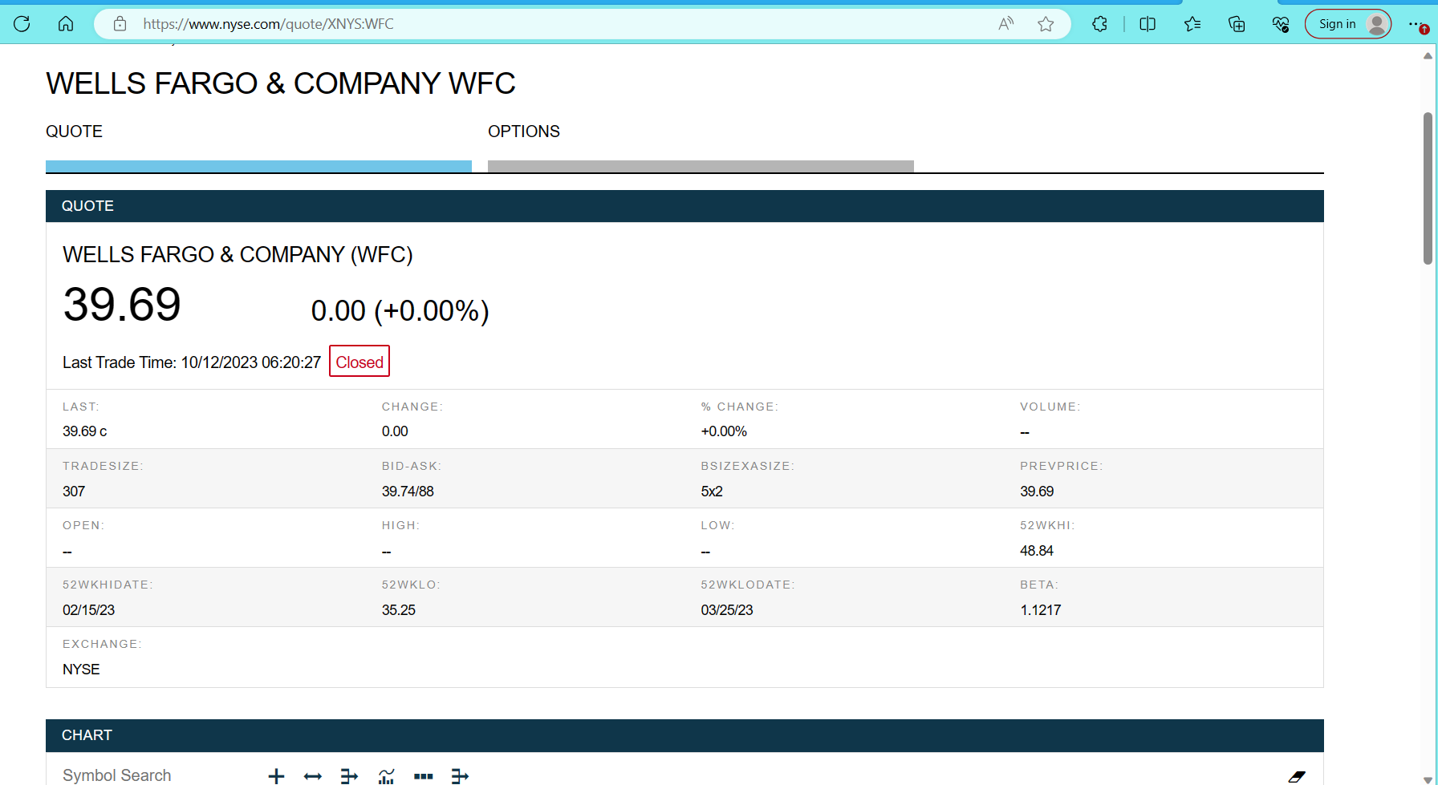
Mock up – Company details
Do you like to purchase this stock?
Yes
No

Slide 10
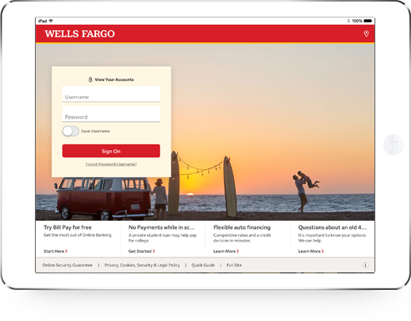
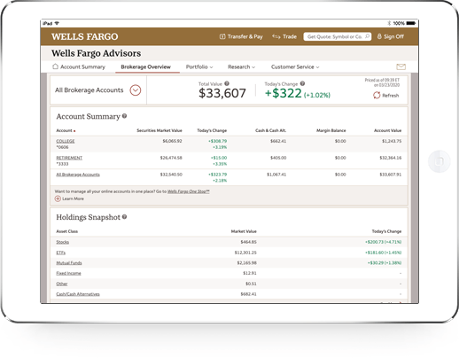
Mock up – Wells Trade application
Back
Back

Slide 11
How the team worked?
We worked in several phases following an Agile approach, considering the Hackathon as one release.
Planning:
We had one release planning session to review all the challenges, decide which one to target considering several factors – value, time, skills, complexity, knowledge etc.
Finalized a high-level backlog required to execute to achieve the goal Ex: Main app, Services & APIs, Documentation, Research items.
Implementation:
We had 5 iterations over Zoom calls to review the work done by each team member on their personal laptops, discuss any constraints and to adjust the plan forward.
Each team member pulled their work from the backlog, based on their skills, availability.
We had road blocks and decided on alternative approaches, ownership to move ahead.
Tie up:
As the work is done separately and was tested independently, we had a 3 hour session to integrate all the code, deploy and test. Some team members worked from office while others worked remotely.
Created Git branch with initial data
Wrap-up:
Had a final call over Zoom to review what is done, what is pending and how we want to close this.
Discussed about some stretch work that we may get done. What went well and what could have been done.
Took a snap and celebrated.

Slide 12
Installation Instructions
Pre-requisites

Slide 13
Challenges & Solutions
Challenge | Possible Solution(s)
Ticker Symbol: It is not easy to get the correct company stock symbol for the given text. We have researched several APIs and consumed one of the public API. | Search engine: Parse/Crawl related finance websites (ex: Yahoo finance) to store data, index it and perform search against the same to know the Ticker symbol. Need to maintain this search database. Consume Stockexchange APIs with payment Ex: NYSE APIs
Brand recognition: There is no API available to give the exact company name for any given logo. We could not implement this in the given timeline. For demo purpose, we thought, we could rely on the file name. | Build our own AI/ML model: Developing a robust logo recognition system requires a large and diverse dataset of logos, as well as extensive training and fine-tuning. Convolutional neural networks are suitable for this case.
Getting company details: After finding the company name and the stock symbol, getting all the details related to the company is not an easy task. We followed a simple solution of redirecting the user to the company page on NYSE website based on the ticker. | Search engine: Parse and crawl the data from each company website, store it in a predefine format. Implement an API for this database, that can return the company details in a standard JSON. No maintenance: To make it simple, we can load the company page on the stock exchange website OR to the company website itself within our application Ex: iFrame.

Slide 14
References
Best stock market APIs: https://rapidapi.com/blog/best-stock-api/
Stock market API: https://twelvedata.com/
Brand logo recognition API https://zylalabs.com/

Slide 15
